Slide 1
Lending case study
Upgrad - Abhishek Jaiswal & Abhi Prasad

Slide 2
Introduction - Lending Club Case Study
Consumer finance company which specialises in lending various types of loans to urban customers. When the company receives a loan application, the company has to make a decision for loan approval based on the applicant’s profile. Two types of risks are associated with the bank’s decision:
If the applicant is likely to repay the loan, then not approving the loan results in a loss of business to the company.
If the applicant is not likely to repay the loan, i.e. he/she is likely to default, then approving the loan may lead to a financial loss for the company
Business Objective
Company has provided the loan data from 2007-2011. Objective is to analyse the data and identify variables which are strong indicator of loan defaults which will give insights to the company whether to approve or reject the requested loan

Slide 3
Data Understanding

Slide 4
Data Understanding
After analysing the data, it has been observed that loan data can be categorized in three category -
User Demographics - Location, Annual Income, Loan Purpose, Employment Length, DTI, Home Owner, etc.
Loan Information - Term period, Loan Amount, Grade, Loan Status, Interest Rate, Installment, Issue Date, etc.
User behaviour towards loan - Public recovery, Revolving Balance, Total account, Outstanding principal, total payment, Delinquency, etc.
As part of analysis, we will be excluding user behaviour towards loan category as these variable are only applicable once loan is granted. These variable may be used to assess if the existing customer who had taken loan is reapplying for the same.

Slide 5
Data Analysis

Slide 6
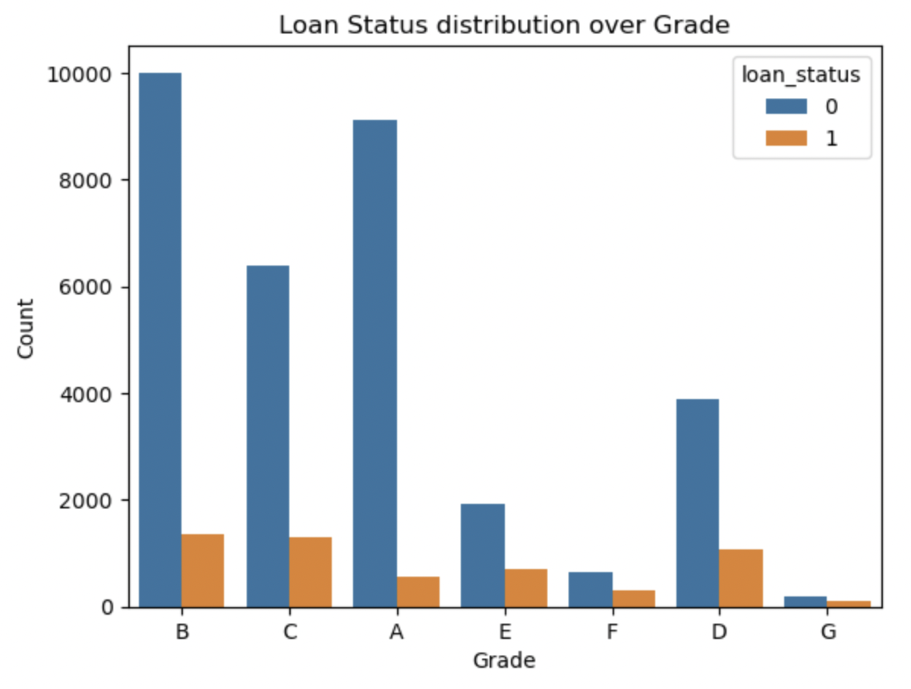
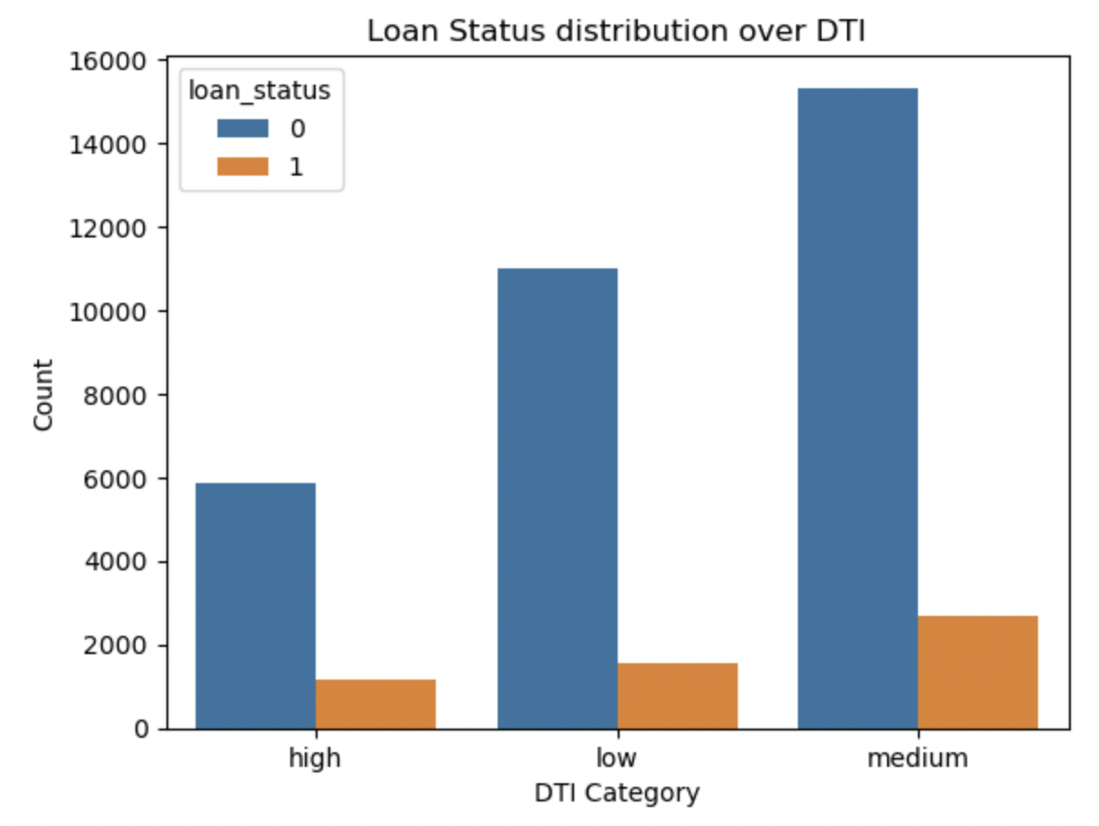
Data Analysis
Loan defaults are more at medium DTI
As a percentage, Grade D, F are more likely to default loans

Slide 7
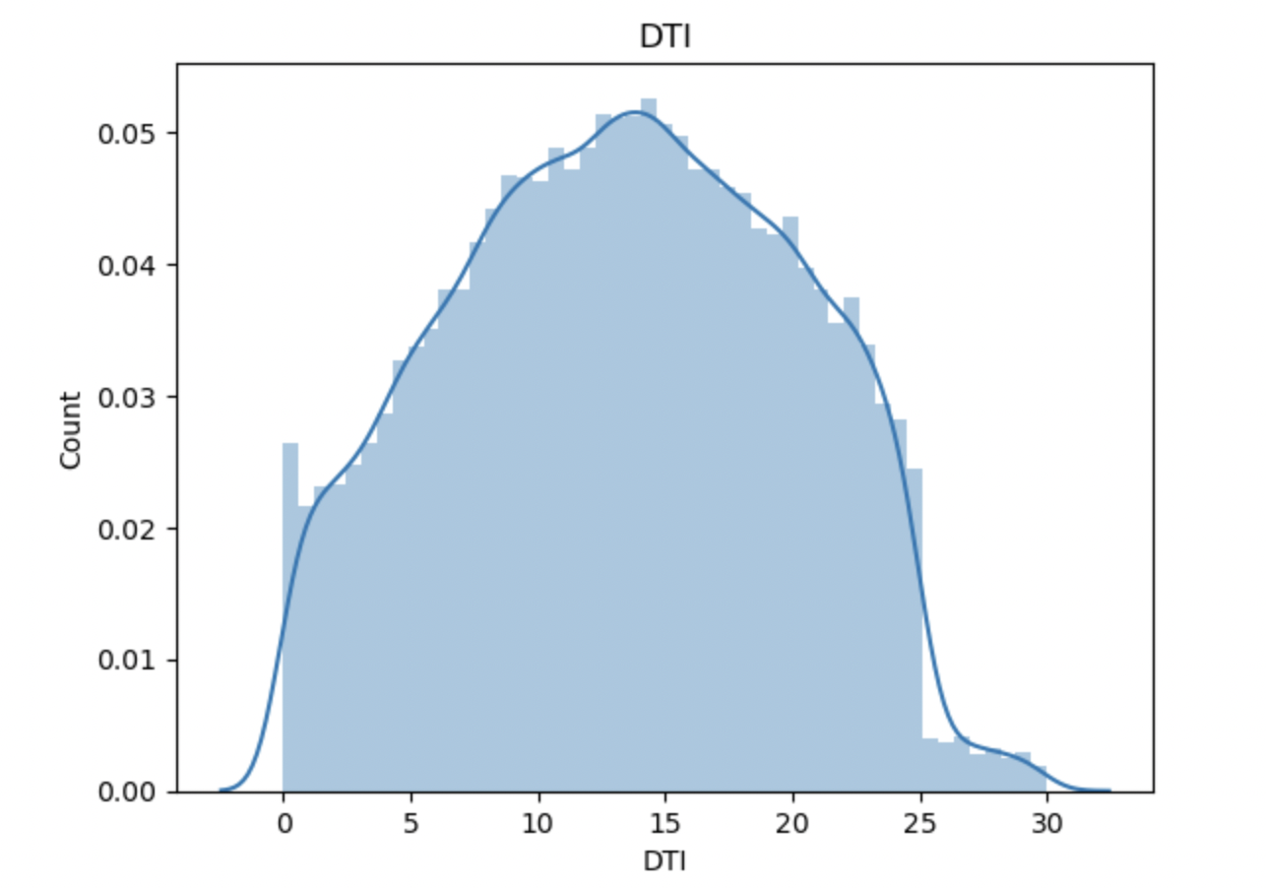
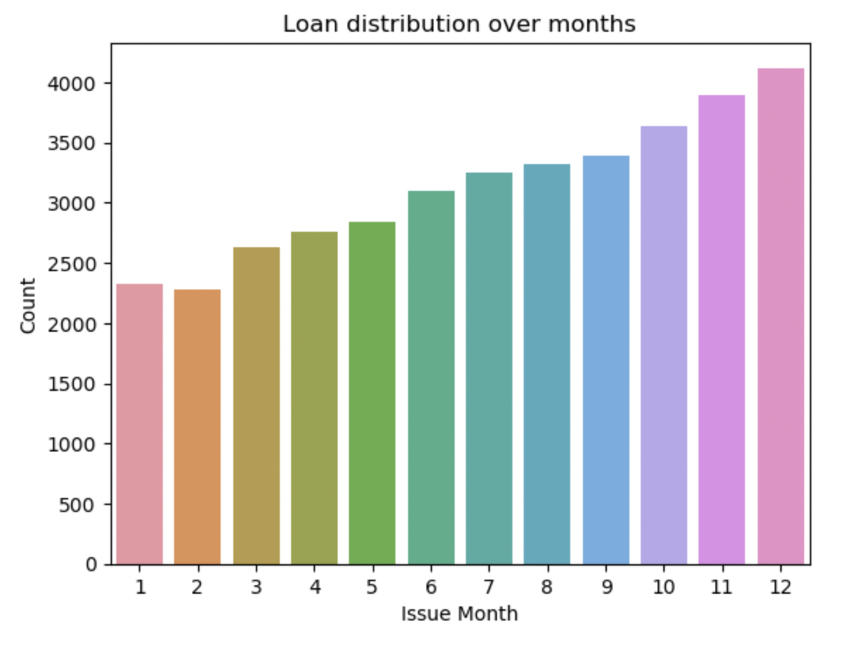
Data Analysis
Most loan holders have higher DTI
Most loans are approved at the end of the year

Slide 8
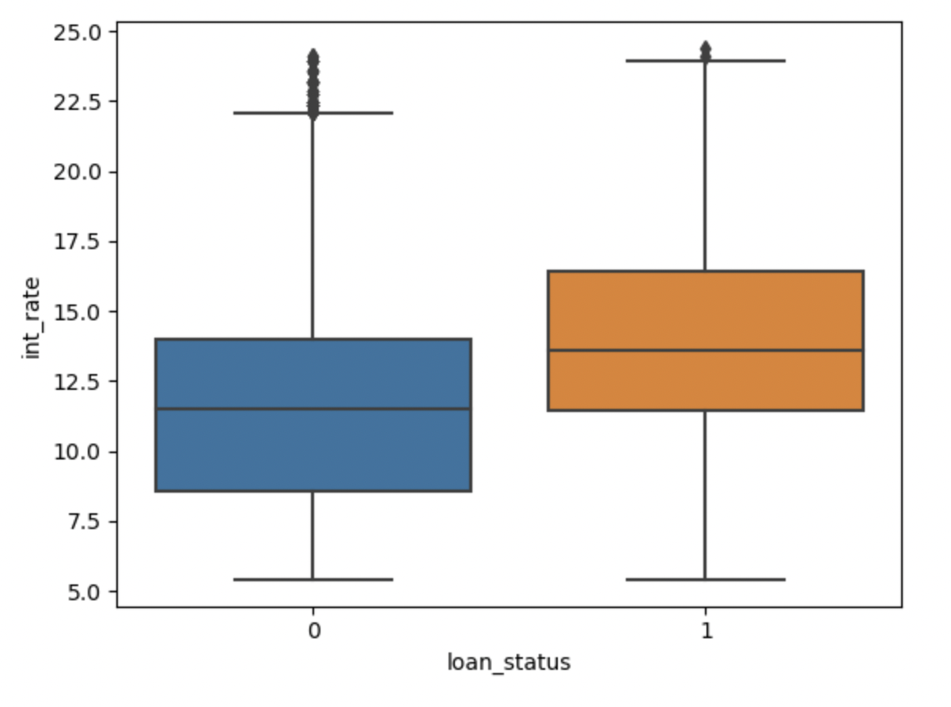
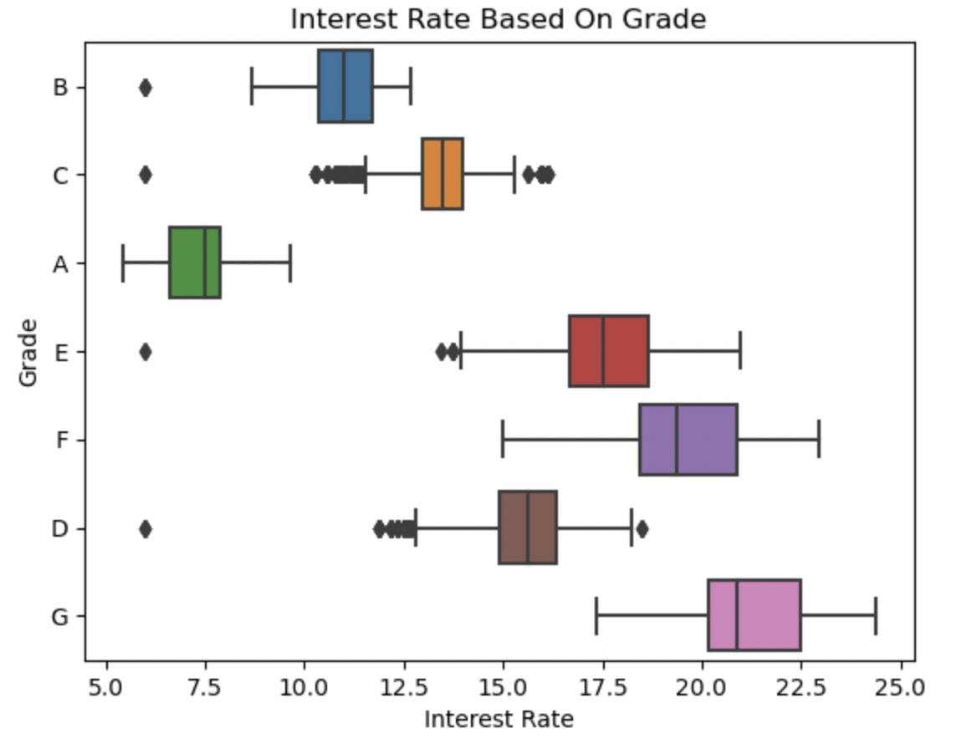
Data Analysis
Loan defaults are high as interest rate increases
Interest rate increases with the increase in grade

Slide 9
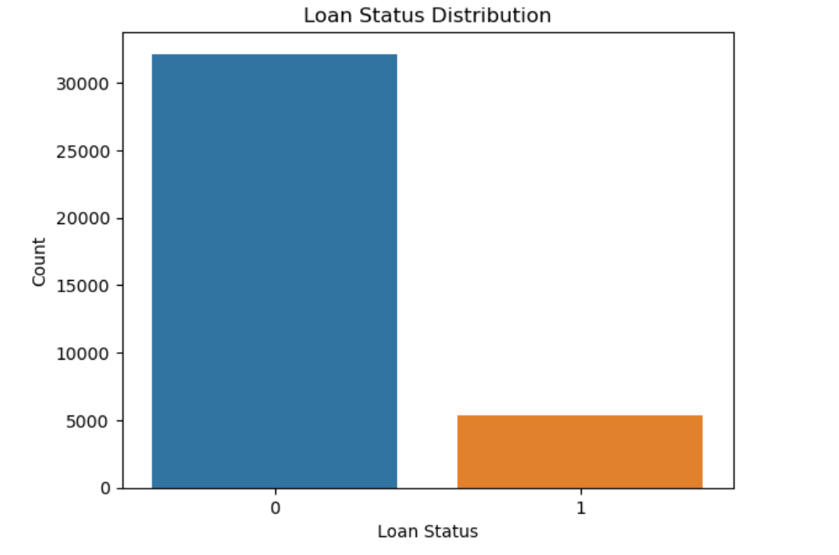
Loan Status
0 - Fully Paid Loan ; 1 - Charged off Loan
Loan defaults are significant lower the Fully Paid Loans.

Slide 10
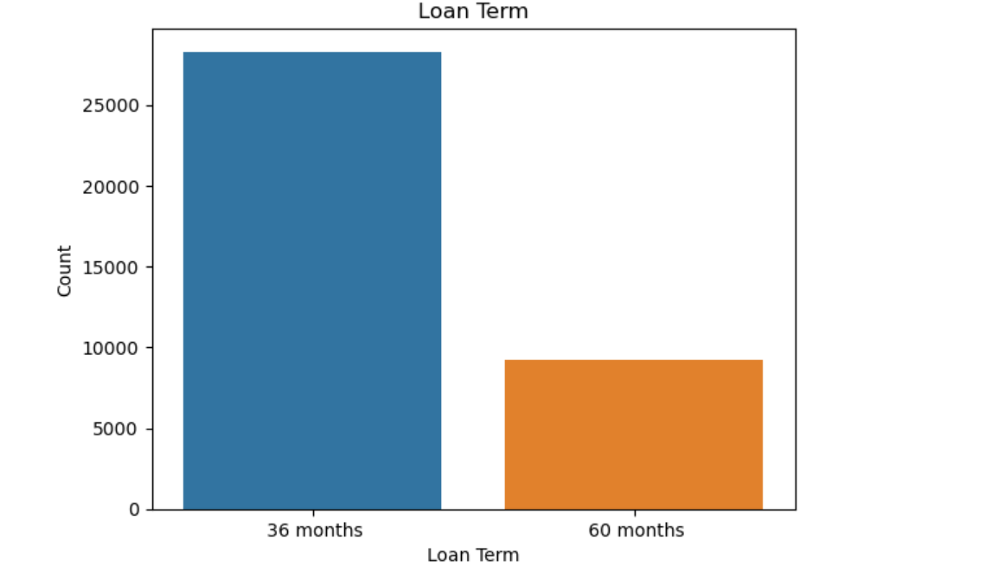
Loan Term
Approved loans are more popular for 36 months term period.

Slide 11
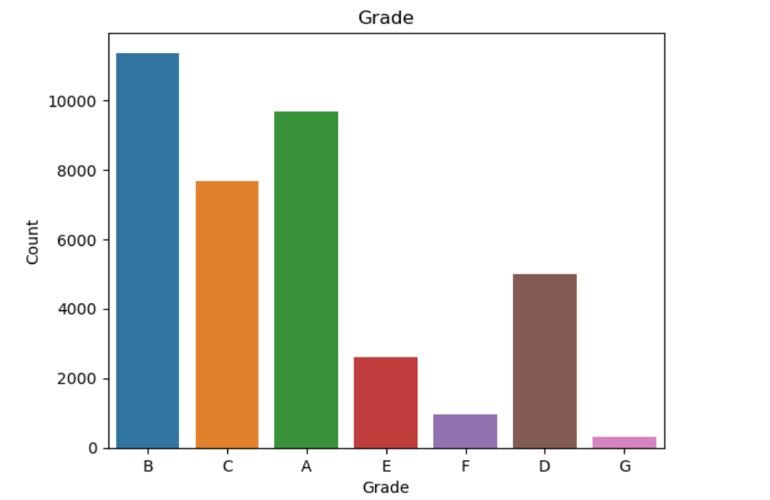
Loan Grade
Most of the approved loans are given to customer having good grade - A, B & C.

Slide 12
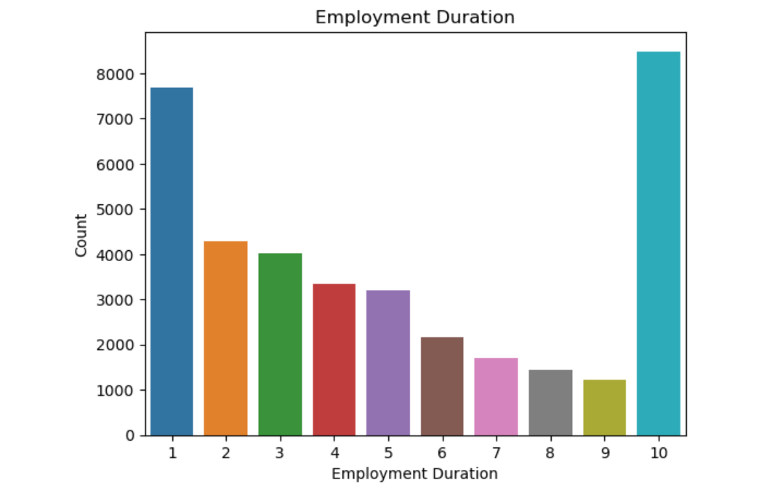
Employment Length
Most of the approved loan are for customer having employment duration more than 10 years.

Slide 13
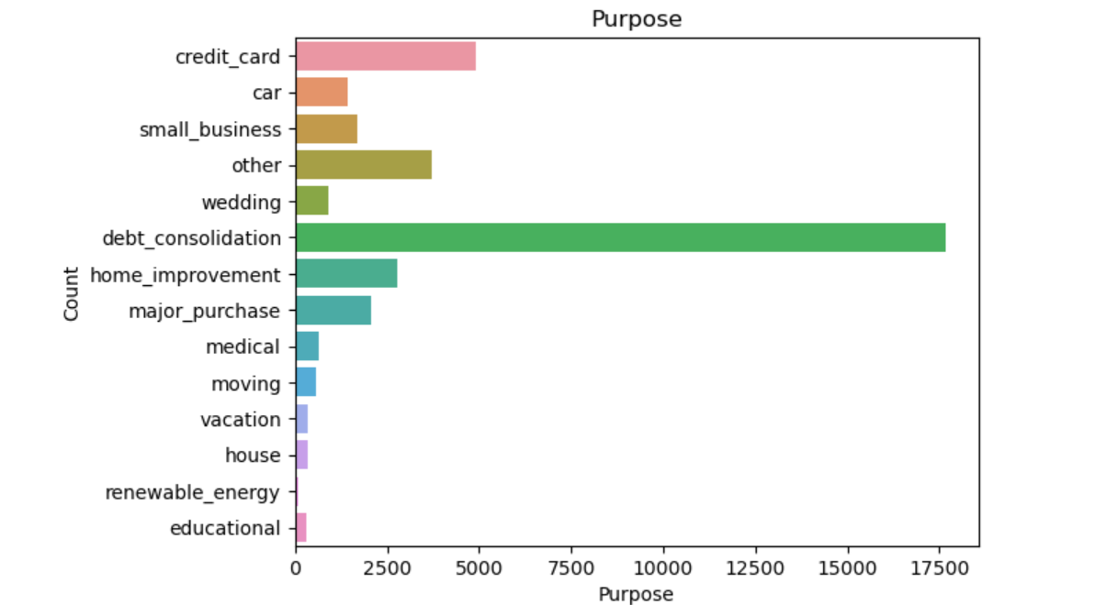
Loan Purpose
Most of the approved loan are for purpose - debt consolidation.

Slide 14
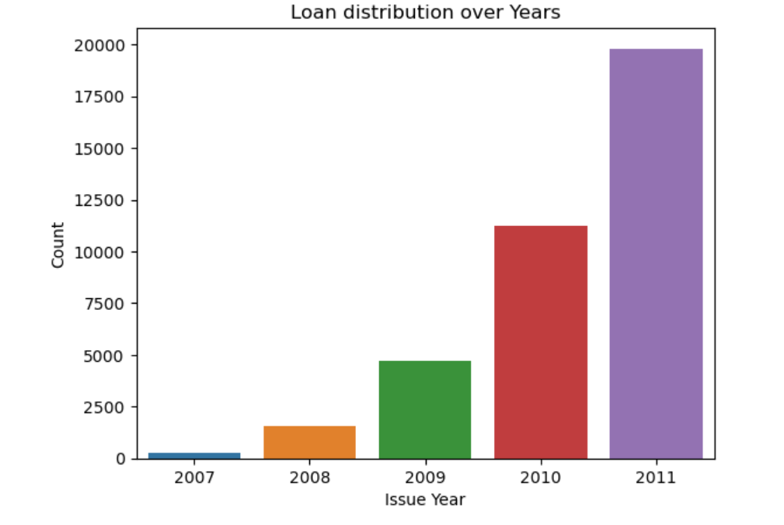
Loan Approved Year
Approved Loan increases with increase of year.

Slide 15
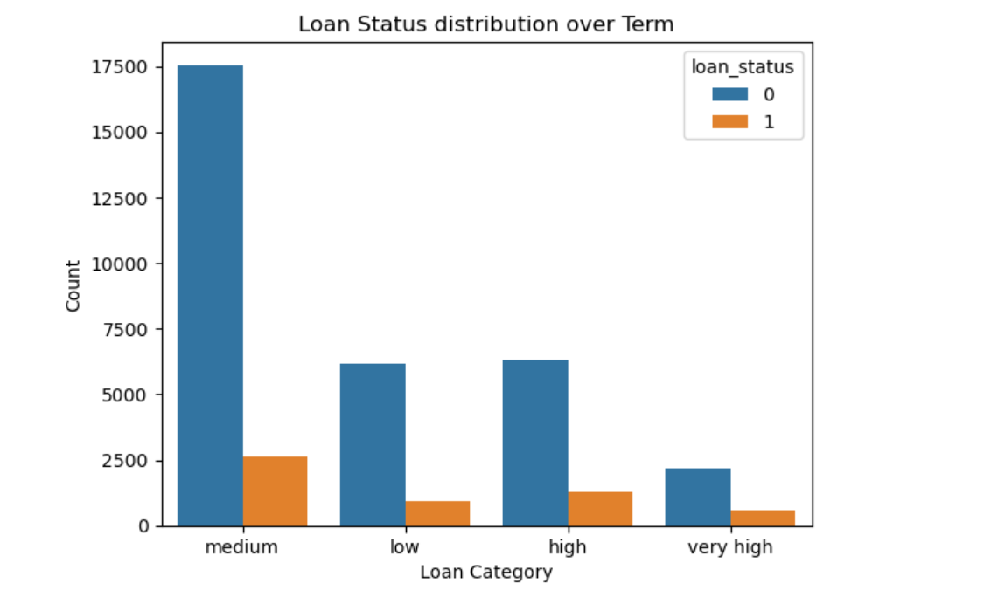
Loan Status vs Loan Amount
Loan defaults increases with increase in Loan amount.

Slide 16
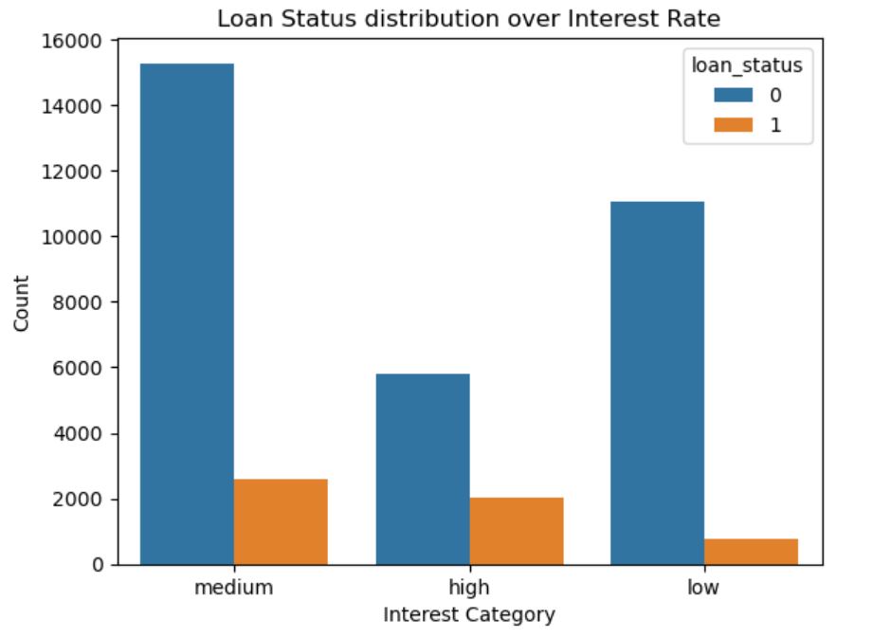
Loan Status vs Interest Rate
Loan defaults increases with increase in Interest Rate.

Slide 17
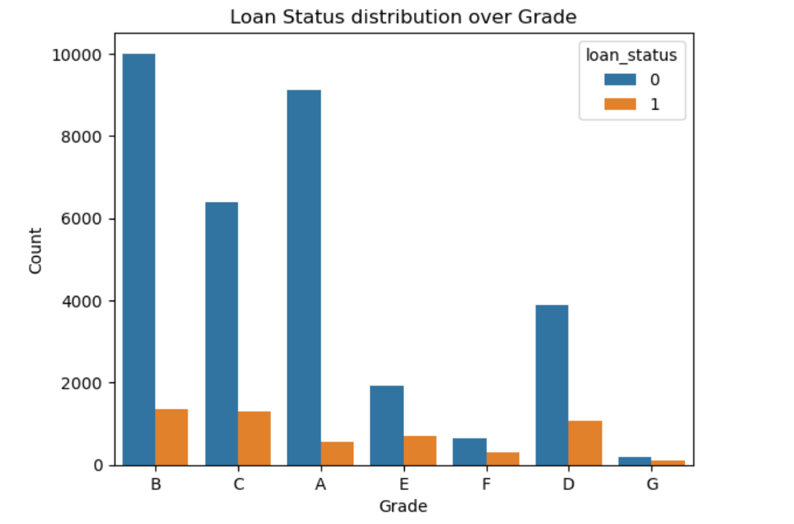
Loan Status vs Grade
Loan defaults increases with decrease in Grade

Slide 18
Loan Status vs Grade
Loan defaults increases with decrease in Grade

Slide 19
Insights

Slide 20
Univariate Analysis
Defaulted Loan are low as completed to Fully Paid loans
36 months term loan is common as compared to 60 months term period.
Lower loans were approved at higher interest rates.
Grade A, B & C holds most of the approved loans.
Most of loan approved are from employee having less than 1 year experience or more than 10 year experience.
Most of loan approved are from borrower staying on rent or on mortgage.
Most number of loans were approved for people having loan amount of 5000-10000. It decreases as the loan amount increases.
Most of loan approved are for people having low income.
Highest number of loan were approved for unverified people.
Highest number of loan approved for purpose - debt consolidation.
Most of the loan holders as high dti.
Most number of loan were issued in last quarter of a year.
Loan approved are increasing with increase is year.

Slide 21
Loan default insights (segmented analysis)
Bivariate Analysis
Installment increases.
People having less annual income.
Loan term increases.
Loan defaults are higher with increase of:
Loan amount
Interest rate increases.
High DTI.
Loan defaults are more with people having grade as D, E, F & G.
Loan defaults are more with people having 2-9 years of experience.
Loan default are increasing with increase of year.
People taking loan for debt consolidation have higher chances of default as well as fully paid loans.
Interest rate increases with decrease of Grade.
Interest rate rises as Loan amount increases.
Interest rate has impact on installment.

Slide 22
Recommendations

Slide 23
Recommendation
Below variables need to be considered for Loan Default -
Grade | D, E, F & G categories tends to default more.
Interest rate | Higher interest rates leads to more defaults.
Installment | Higher installment values tends to default more
DTI | People with high DTI tends to default mor.
Annual Income | Low income tends to default more often.
Loan Purpose | Loan given for purpose different than Debt consolidation should be analysed as they have more defaults.
Verification status | Loans offered without verification status are more likely to default

